Slide 1

Architecture
Mr Butler

Slide 2


You should be able to
describe the internal components of a computer system: processor, clock, main memory, cache memory, buses (address, data and control), I/O controllers, registers and ports;
describe the fetch-execute cycle;
evaluate the factors that can influence the speed of processing: processor type and clock speed;
explain the need for secondary storage;
describe secondary storage media: magnetic, optical and flash;
evaluate the use of secondary storage media for common applications;

Slide 3
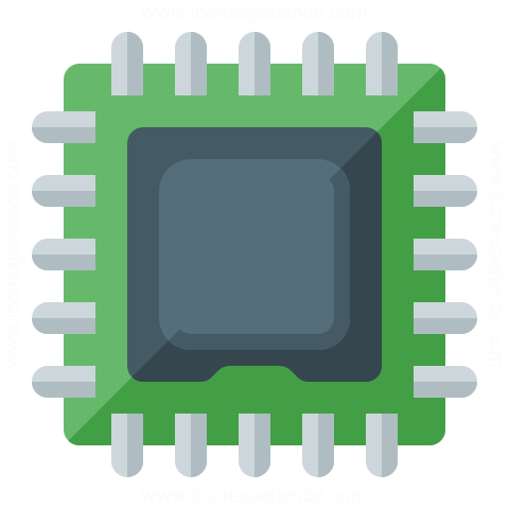
The Processor
The Central Processing Unit (CPU) is the main part of the computer, consisting of:
  the registers,
  arithmetic logic unit (ALU) and
  control unit. Usually the CPU includes the main memory (Immediate Access Store - IAS). Many computers have more than one processor.
A special form of CPU is the microprocessor, which is used in microcomputers and small computerised devices, e.g. the control circuits of washing machines or mobile phones.
A microprocessor is an integrated circuit where the components of the CPU excluding the main memory, are combined as a single unit. Microprocessors are manufactured for use in microcomputers and small computerised devices.

Slide 4
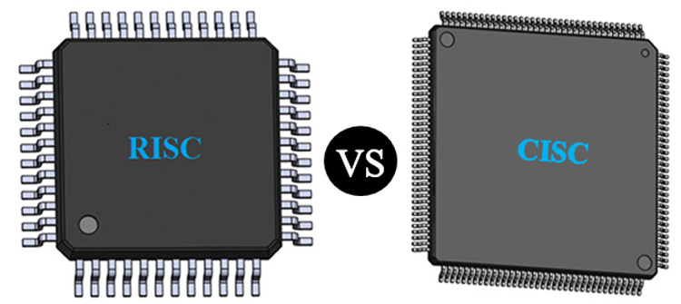
There are two approaches to the design of Microprocessors:
Complex Instruction Set Computer (CISC).
  This is a design that produces a complicated and expensive integrated circuit capable of performing a large variety of complex operations.
  Integrated circuits made to these designs can perform complex operations very efficiently with a small number of machine instructions.
  The complexity of the circuitry makes them relatively slow to perform each machine instruction, expensive to produce and they have high power consumption.
  They are usually used for general purpose computers.

Slide 5
There are two approaches to the design of Microprocessors:
2. Reduced Instruction Set Computer (RISC).
  This is a design that produces a simple cheap integrated circuit with a basic range of machine instructions.
  Integrated circuits made to these designs are fast and rely on speed to perform complex operations by using several machine instructions.
  It can be customised cheaply and for specific applications and is particularly suited to specialised applications that require fast but limited processing or have environmental considerations such as low power consumption.
  Typical applications include laser printers, MP3 players, personal organisers, mobile phones and most games consoles.

Slide 6
Instruction Set
This is the complete collection of instructions that are used by a particular type of central processor.
These are the instructions available for use in machine-code programs or assembly-language programs for that computer.
The instruction set is part of the design of a central processor or microprocessor and so, the machine code of different types of computer are rarely compatible.

Slide 7

Machine Code Instructions
A machine code instruction is a binary code that can be directly executed by the computer. Each type of computer has a set of binary codes that are recognised by its processor as instructions (the Instruction Set).
Each type of processor has a different instruction set. These are the only instructions that can be used to control the computer.
Other instructions (such as those written in Pascal or C# etc) must be converted into appropriate machine code instructions before they can be executed by the computer.

Slide 8
Machine Code Instructions
Each instruction is a binary pattern that can be decoded by the Control Unit. It consists of several fields, including the operation code field and usually an address field. The operation code field is the part of the binary code for the instruction to be carried out (eg JUMP or ADD).
An address field gives the address where the data to be used in the operation can be found.
  It is sometimes called the operand field or simply the operand.
The most common format of a machine code instruction consists of two fields, the operation code field and the address field.
  This is known as a single address instruction. (Multiple address instructions have more than two fields and there is always an operation code filed and at least two address fields).

Slide 9
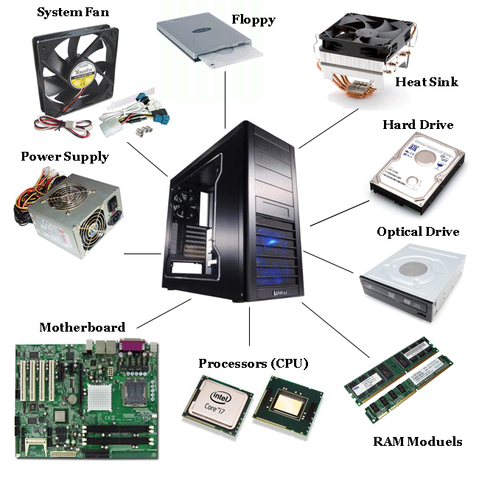
Internal Components
Computer systems generally consist of three main components:
  the internal components that are involved in processing data and/or a set of instructions in the form of a computer program,
  memory which holds the programs and data being processed and
  input /output devices; used for communication with the outside world.

Slide 10
Processor
The processor consists of the Control Unit (CU), a series of registers and the Arithmetic Logic Unit (ALU).
Processor
Control Unit
ALU
Registers

Slide 11
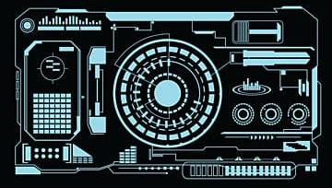




The Control Unit
The control unit is a digital circuit that co-ordinates the movement of data, the sequencing of instructions and directs the operation of the other components of a computer system by providing control and timing signals.
The control unit is therefore the part of the central processor that manages the execution of instructions. It fetches each instruction in sequence, decodes and synchronises it before executing it by sending control signals to other parts of the computer. This is known as the fetch execute cycle.

Slide 12
The Fetch Execute Cycle
The fetch execute cycle is the complete process of retrieving an instruction from store, decoding it and carrying it out.
Part of the control unit is the instruction decoder, which decodes the machine code instructions during the fetch execute cycle and determines what actions to take next.
The cycle consists of two phases, the fetch phase which when the instruction is copied into the control unit and decoded, followed by the execute phase in which the instruction is obeyed (see later notes).

Slide 13
The CPU Clock Speed
Timing signals are provided by an internal clock which helps to synchronize the operation of the internal components and which helps determine how many computer instructions are carried out (executed) each second.
The clock is an electronic unit that synchronises related components by generating pulses at a constant rate.
The clock rate is the frequency at which the clock generates pulses.
  The higher the clock rate, the faster the computer may work.
  One limiting factor for machine speed is the manufactured tolerance of the slowest component.
The CPU needs a certain number of clock ticks to carry out each instruction. Clock speed is expressed in megahertz (MHz) or gigahertz (GHz).

Slide 14
The ALU
The Arithmetic Logic Unit (ALU) is a digital circuit which forms part of the processor.
  It is the part of the CPU where data is processed and manipulated.
  Carries out mathematical operations and logical comparisons on data associated with instructions being executed.
  Most operations involve the accumulator, a special storage register within the ALU.
    It is used to hold the data currently being processed by the Central Processor.
    Any data to be processed is temporarily stored in the accumulator, the results ending up in the accumulator before being stored in the memory unit.
  Most computer calculations are based on addition methods and so the accumulator is where the computer does its additions. A computer performs subtraction by two’s complement addition and multiplication by combining addition with shifts for column alignment.
The ALU usually includes arithmetic registers which are special store locations used to hold operands and results temporarily during calculation.

Slide 15
Internal Memory
Much as we need to remember steps and values to perform even the simplest calculations, so too must the processor have somewhere to store the data and instructions currently being operated upon.
Main memory and cache memory are two types of memory used by the processor in the execution of instructions.
Processor
Control Unit
ALU
Registers
Cache Memory
Main
Memory

Slide 16
Main Memory
Main memory is often referred to as RAM or Random Access Memory.
  Main memory (RAM) at any time during the operation of the computer stores a portion of the operating system, application software currently running and other data items the processing unit needs when carrying out operations.
Main memory is volatile, meaning when the power is removed from the system the data will be lost,
Referred to as random access memory because the processor can go directly to any location to access an item of data;
  does not have to access the memory locations in a particular (sequential) order.
  Main memory is also sometimes called IAS – Immediate Access Store.

Slide 17
The IAS
The IAS is therefore the part of the computer system where the data and instructions are held for use by the Central Processor and where the central processor puts the results it generates. The computer store is made up of a large number of identifiable units called store locations.
Each store location has a unique label, called an address, which is recognisable and is used by the central processor.
Those store locations that can be addressed directly by the central processor are called the main store, immediate access store (IAS) or primary store.
  A store location, sometimes called a memory cell, is capable of holding a single item of data, a word or a byte. (A byte is a group of bits, typically 8, representing a single character. A word is a group of bits that can be addressed, transferred and manipulated as a single unit by the central processor.
  The size of a word, ie the word length, is determined by the width of the data pathways (buses) within the computer and is usually larger than a byte.
  Large word sizes mean that a computer can transfer data in larger groups than a computer with a smaller word size, and this generally means faster operation).

Slide 18
Cache Memory
Cache memory is a form of RAM which can be accessed, by the processor, at a faster rate than main memory.
It is high speed volatile memory that is often integrated into the processor chip or it may sit between the processor and main memory in the form of a separate memory chip.
Cache memory is used to store copies of the contents of the most frequently used memory locations. During the processing of data items, the processor will search cache first before searching the main memory.

Slide 19
ROM
Read Only Memory. This is non-volatile (permanent) main memory. In other words it is only able to be read from not written to.
There are 2 possible forms:
  Once the data has been written to the memory it is fixed and unalterable by any means – the data is often written at the time of manufacture of the device it is in.
  The data may only be altered by the use of special facilities (eg by a program or hardware) – such memory chips are known as programmable memory chips and their uses include storing programs for controlling devices (eg traffic lights and lifts) and in computer games consoles. When a computer is switched on it loads a program from such a group of chips (called the BIOS), this allows for the BIOS to be upgraded later if necessary. The process of upgrading the data on such chips is often referred to as a flash upgrade.

Slide 20
Boot/Bootscript and Booting Up
This is the process of starting up the computer by loading a short sequence of machine code instructions, which in turn load an operating system ready for use (see BIOS below). These instructions are normally held in read only memory (ROM) and activated when the machine is switched on. This process is sometimes referred to as booting up or booting.
It is possible to control the start up. This may be done by placing the required commands in a file, called a boot file, sometimes called a bootscript. This file will be executed automatically by the computer after it has booted up the operating system.
To reboot the computer is to restart the system. This may be after the system has hung. The system may also need to be rebooted to complete the installation of some hardware and software. The computer will start up as if it had just been switched on, so data that had not been saved by the user, or saved automatically, will be lost.

Slide 21
BIOS (Basic Input Output System)
This is a machine code program that handles the low-level input and output operations such as those relating to the keyboard and screen of the system. It provides an interface between the hardware and the operating system.
Suppliers usually provide the BIOS with the hardware in the form of non-volatile memory.
  It is usually considered to form the lowest level of the operating system.
  In order to make it possible for a range of different operating systems to be installed without the supplier having to modify the operating system for different hardware platforms, the BIOS has to comply with one of a range of agreed common standards.
  The BIOS in most systems can be updated. This allows a newer version of the BIOS to be loaded.

Slide 22
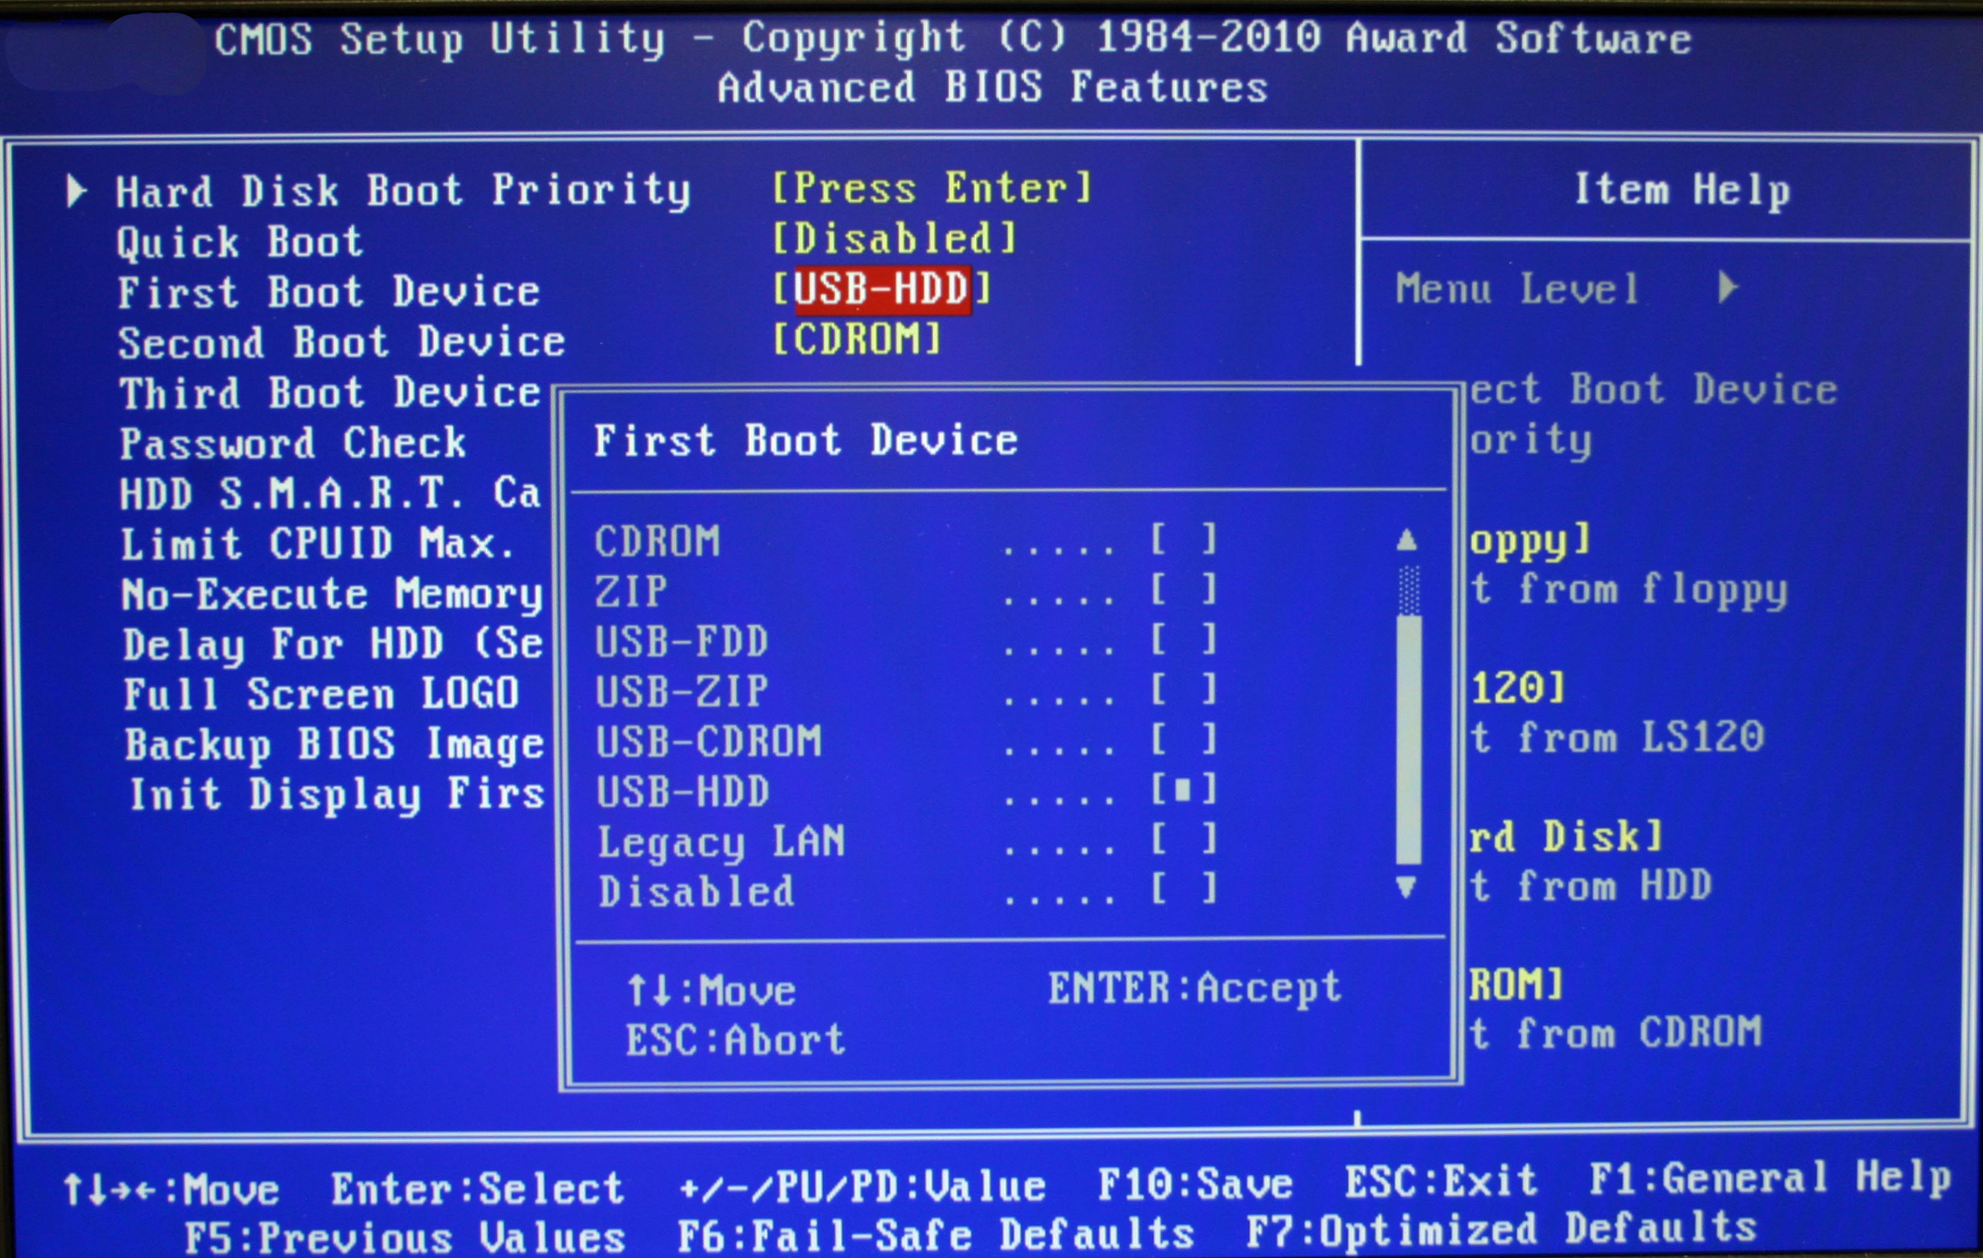
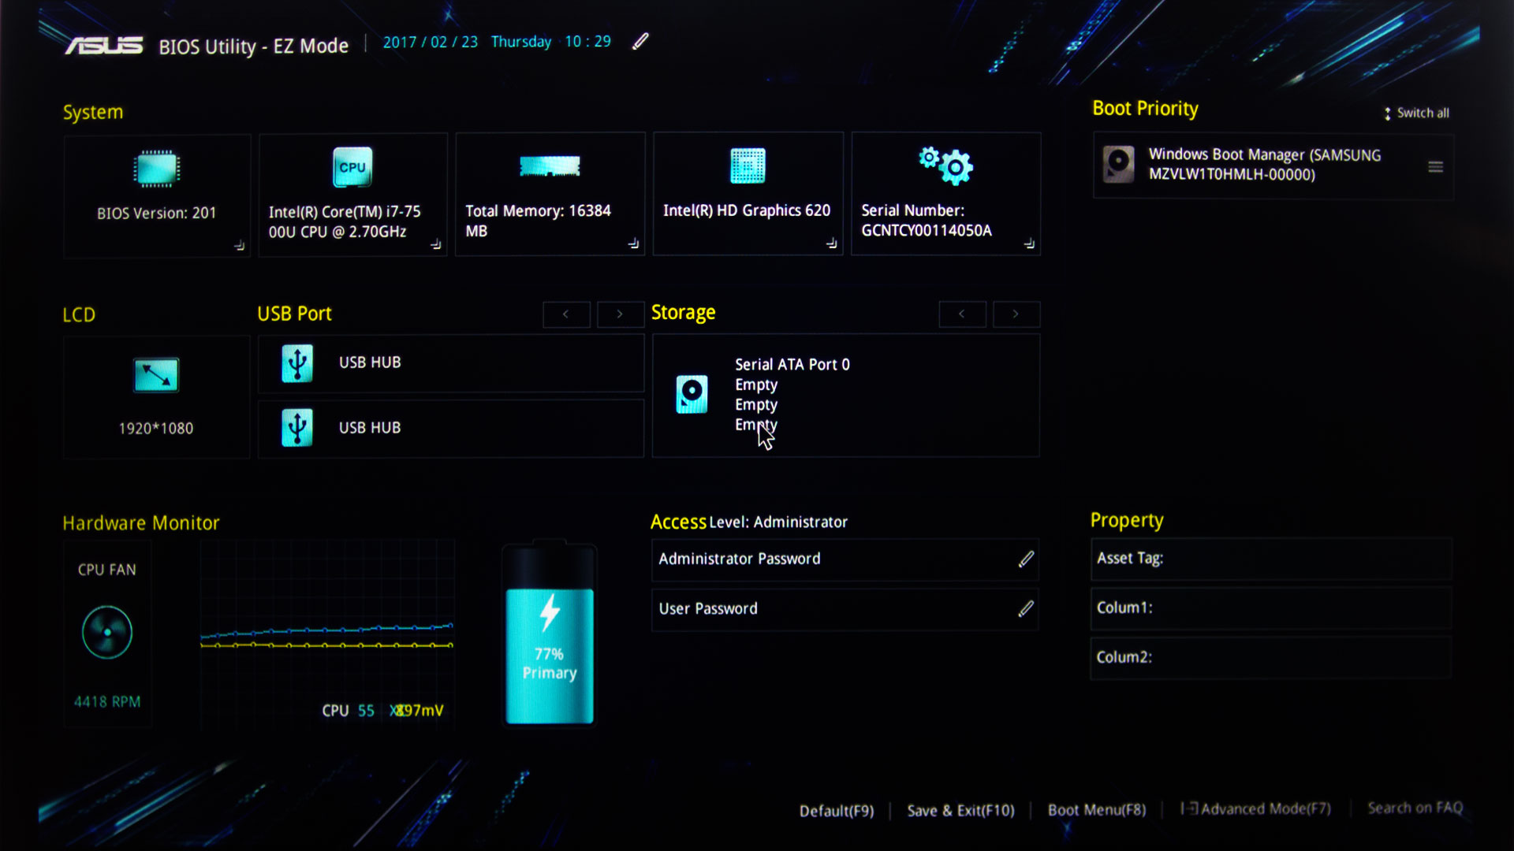

Slide 23
Question Break
The CPU of a computer includes a control unit and internal memory.
1. Explain the purpose of the control unit. [3]
2. Identify three different types of internal memory and describe how each is used. [3 * 3]
A computer uses a stock control system.
3. Describe three ways this computer could use RAM [6]
4. State and justify one way in which ROM is used. [2]

Slide 24
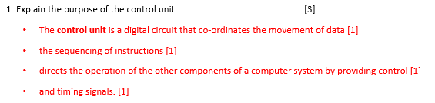
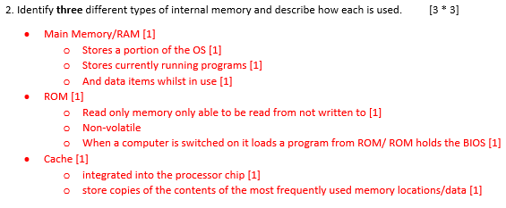
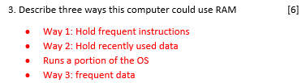

Temporary Data Storage: RAM is used to store temporary data such as current stock levels/sales/customer information. When stock levels are updated or new transactions occur, this data is quickly written to RAM for fast access, allowing for real-time updates without the latency of accessing secondary storage like a hard drive.
Running Applications: The stock control system software runs in RAM. This enables quick execution of commands, and efficient processing of tasks such as generating reports or processing orders, ensuring that users have a responsive experience.
Caching Frequently Accessed Data: RAM can be used to cache frequently accessed data, such as product information/pricing/stock levels. By keeping this information in RAM, the system reduces the need to repeatedly access slower storage, improving performance

Slide 25




Buses
Operating in isolation, each of the internal components of a typical computer system has a very specific function. Communication between each of these components is necessary during the execution of program instructions.
Communication systems known as buses are used to support the transfer of signal between the internal components of computer system (internal buses) and to allow for communication with the various input and output (I/O) devices used for communication with the outside world (external buses).
A bus is basically a set of physical connections in the form of set of physical cables or printed circuits used to connect the various hardware components used in the execution of a set of instructions.

Slide 26
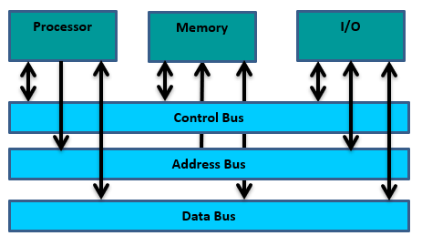
Bus | Function
Address Bus | Will be used to identify a physical location in memory to be accessed. The location may be accessed to read data from or write data to memory. If an item of data is to be stored in memory, the location to be used as a repository for the data item will be identified using the address bus.
Data Bus | Allows for the transfer of data between one component of a processor or computer system and another. If an item of data is to be stored in memory, the data item will travel to the memory location via the data bus.
Control Bus | Carries commands from the CPU to other devices in relation to the instructions being executed at a particular time. E.g. if an item of data is to be stored in memory the control bus will carry the write command to the memory location.

Slide 27
Ports
While buses allow for the transfer of data between various components in a computer system it is important to also consider how the data can be transferred from the input/output devices to the internal components of the computer. To allow data to be transferred from peripheral devices they must be connected to the computer via an Input/Output (I/O) port.
Types of computer ports include:
  Serial port which transmits one data bit at a time across a single wire, used mainly for connections to mice and modems.
  Parallel port which transmits multiple bits of data over multiple wires at one time and can be used to connect some printers to the processor/computer.
  USB (Universal Serial Bus) ports now provide a high speed serial connection to most types of peripheral devices.

Slide 28
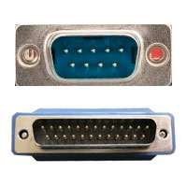
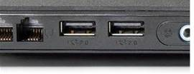
Serial Port
Parallel Port
USB Port
There are many other ports – including display port and USB type C ports. However the above are the ports you need to be aware of.

Slide 29
Registers
A register is a high speed memory location forming part of the processing unit. They are used for a specific purpose and temporarily store data or control information. Registers are much faster to access than the IAS.
The registers listed overleaf have an important role to play in the processing of instructions by the control unit in what is known as the fetch-execute cycle.

Slide 30
Register Name | Function
Program Counter (PC) | The PC is in the Control Unit and it stores the address/location in memory of the next program instruction to be executed. As soon as an instruction has been fetched from memory the contents of the program counter are incremented (1 added to it) to ensure it points to the next location to be accessed. (Also called the Sequence Control Register or SCR). When computers switch between running programs, they need to change the contents of the CPU. This is where the program counter performs a ‘jump cycle’ and changes its content to the new program
Memory Address Register (MAR) | In the Central Processor. Stores the address of a memory location to be accessed either for a data/instruction read or write i.e. it stores the address of the memory location currently in use. In the fetch phase this would be the address of the instruction being loaded and in the execute phase the address of the data being used. The memory unit has access to the MAR and switches the address selection circuitry to access the appropriate location.
Memory Data Register (MDR) | Also in the Central Processor. Stores data that has just been fetched from memory or data waiting to be stored/written to a location in memory i.e. it stores data being transferred to and from the IAS. It acts as a buffer allowing the Central Processor and memory unit to act independently without being affected by minor differences in operation. A data item will be copied to the MDR ready for use at the next clock pulse, when it can either be used by the Central Processor or stored in main memory. (The MDR is also known as the Memory Buffer Register or MBR).
Current Instruction Register (CIR) | Stores the instruction currently being executed by the processor

Slide 31
The Fetch Execute Cycle
The fetch-execute cycle is the process used by a computer to retrieve a program instruction from memory, determine what that instruction is expected to do and then carry out the actions associated with that instruction. Let us now consider how the registers and buses outlined previously can be used as part of the fetch-execute cycle.
The address of the first instruction to be read is loaded into the Program Counter (PC).
Before data/instructions can be accessed from main memory the contents of the Program Counter (PC) are placed in the Memory Address Register. (The MAR will use the address bus to access the location where the instruction is stored).
The Program Counter (PC) is immediately updated (incremented by 1) to point to the location of the next instruction to be executed.
A read signal will be sent via the control bus to memory and the instruction is transferred from memory to the Memory Data Register (MDR) via the data bus.
The instruction is then copied into the Current Instruction Register (CIR) where it will be examined or decoded by the processor.

Slide 32
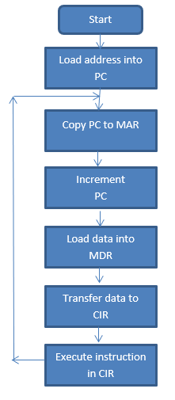
The flowchart shows how this process is repeated for each instruction being executed as part of a larger program).

Slide 33
Factors influencing the speed of processing
By manipulating some of the components previously examined we can affect the speed of operation of the CPU.
Clock speed
Previously we looked at how microprocessors use an internal clock to control the number of instructions to determine how many instructions are executed per second by the CPU. If the CPU requires a specific number of clock ticks to execute an instruction then by increasing the clock rate (the number of clock ticks / cycles per second) we can increase the number of instructions executed per second; i.e. the faster the clock speed, the more instructions the CPU can execute per second.
Cache size
Cache memory provides high speed access to the most frequently used instructions and data items. By increasing the size of cache memory we can also increase the number of instructions and or data items being held in fast access memory in close proximity to the processor. Increasing the speed of access to a greater number of frequently accessed instructions and data items can help to increase the speed of operation of the processor.
Processor Type
Most computing devices can use one of two main types of processor known as Reduced Instruction Set Computing (RISC) or Complex Instruction Set Computing (CISC).
As the name suggests RISC has a smaller number of instructions at its disposal during processing. This means that in complex processing tasks RISC processing units have to combine many simple instructions to complete each task meaning an increased number of fetch-execute cycles need to be completed to carry out complex tasks; thus slowing down the overall speed of processing.
Notes:
Reduced version on next slide

Slide 34
Factors influencing the speed of processing: Reduced
By manipulating some of the components previously examined we can affect the speed of operation of the CPU.
Clock speed
The CPU speed can be increased the clock rate (the number of clock ticks / cycles per second) we can increase the number of instructions executed per second
Cache size
Cache memory provides quick access to frequently used instructions and data items. Increase size of cache memory = increase the number of instructions/data items held in fast memory in close proximity to the CPU. More Cache = More instructions stored in fast speed access = faster CPU speed
Processor Type
Two types of processor: RISC or CISC.
RISC has a smaller number of instructions available during processing. This means that RISC has to combine many simple instructions to complete each task in order to complete complex tasks; overall speed of processing is increased.

Slide 35
D:\Digital Technology\A Level\AS Level\AS 2 - Mr B\3 – Architecture
Architecture Notes 2_2018_19

Slide 36
Storage
Main Memory and Backing Store

Slide 37
Memory Consists of
MAIN MEMORY
Another term is PRIMARY STORE
BACKING STORE
Other terms include Auxiliary Storage or Secondary Storage
RAM
OPTICAL MEDIA
ROM
CACHE
MAGNETIC MEDIA
SOLID STATE MEDIA

Slide 38
Main Memory = Primary Storage
Main memory keeps track of what is currently being processed.
It's volatile, meaning that turning the power off erases all of the data. #
For Main Memory, computers use RAM, or Random Access Memory.
  These memory chips are the fastest, but most expensive, type of storage.
  No matter what you are working on, whether at home, school or in an office, you will want to save your data for use at a later date.
  Whilst you have the document, spreadsheet, database open, the work is mostly residing in your computer's Random Access Memory (RAM).
  However, as you know, this is volatile, so when you turn your computer off, all of your work will simply disappear unless you save it to somewhere more permanent.

Slide 39
Backing Storage = Auxiliary Storage = Secondary Storage
Auxiliary storage holds what is not currently being processed. This is the work that is "filed away", but is ready to be pulled out when needed. It is non volatile, meaning that turning the power off does not erase it.
Auxiliary Storage is used for:
  Input - data and programs
  Output - saving the results of processing
So, Auxiliary Storage is where you put last year's tax info, addresses for old customers, programs you may or may not ever use, data you entered yesterday - everything that is not being used right now.

Slide 40
Role Of Storage Devices
Storage devices are designed to hold your data on a permanent or semi-permanent basis. They are non-volatile, i.e. when the computer is switched off, the data will still be safe.
Storage media can be classified into two categories:
  Media that can be over-written many times.
  Media that can only be written onto once.
Storage devices are sometimes referred to as secondary storage.
Secondary Storage can be classified into the following types:
  Magnetic Media (Magnetic tapes, floppy disk, Zip disk, hard disk)
  Optical Media (CD-ROM, DVD’s)
  Solid-State Media (Flash memory)

Slide 41
Secondary Storage – Why is it necessary?
You will remember that main memory at any time during the operation of the computer stores a portion of the operating system, application software currently running and other data items the processing unit needs to have fast and direct access to when carrying out operations. Main memory will hold these items only for as long as they are being used by the processor. It would be unrealistic to assume that all programs and data being held by the computer could be held indefinitely as:-
  Main memory is volatile, meaning that as soon as the power is removed the data is lost;
  Main memory has limited capacity.

Slide 42
This means for example that if main memory is volatile we have:
  no means of being able to permanently store the results of processing,
  means that we would have to reprogram our computer to complete a task each time we needed to use them.
  This would greatly negate the advantages of having high speed processors to complete tasks for us. For this reason we need to have a secondary or an auxiliary storage device which can be used to hold copies of the programs we are using so they can be reloaded for use without the need for reprogramming. We can also therefore use secondary storage devices to allow us to reload the results of previous processing.
Using secondary storage devices to keep a permanent copy of our processing means that other people can use the same computer but also; depending on the features of the device and its portability in particular, we can take the results of processing and use them on another computer.

Slide 43
Activity: Research Question
Explain the difference between internal memory and secondary storage.
The above question is your title. Using what you have learnt, develop a mind map to display the differences. Your mind map should include benefits and examples, as well as how the differ physically.

Slide 44
Magnetic, optical and flash storage media
A variety of media exist for use as backing storage devices. These devices can be categorised as Magnetic, Optical and Flash.

Slide 45
Magnetic Media
Magnetic media refers to devices which use different patterns of magnetisation to store data. Magnetic storage devices provide a non-volatile storage medium. Hard discs represent one example of magnetic storage media. Information can be read from and written to the disc using read/write heads which operate very closely to the surface of the disc. A magnetic material, such as iron oxide or chromium oxide, is embedded in the disk.
To record data, a recording head moves past the disk while electric currents passing through it produce a magnetic field. Data on the disc is stored in a very orderly pattern on the disc surface. Bits of data are arranged in concentric, circular paths called tracks.
  Each track is broken up into smaller areas called sectors.
  The magnetic surface of the hard disc drive is contains tiny magnetic regions known as domains and each domain can be magnetised on one of two polarities to represent 1 or 0. Domains are invisible to the human eye.

Slide 46

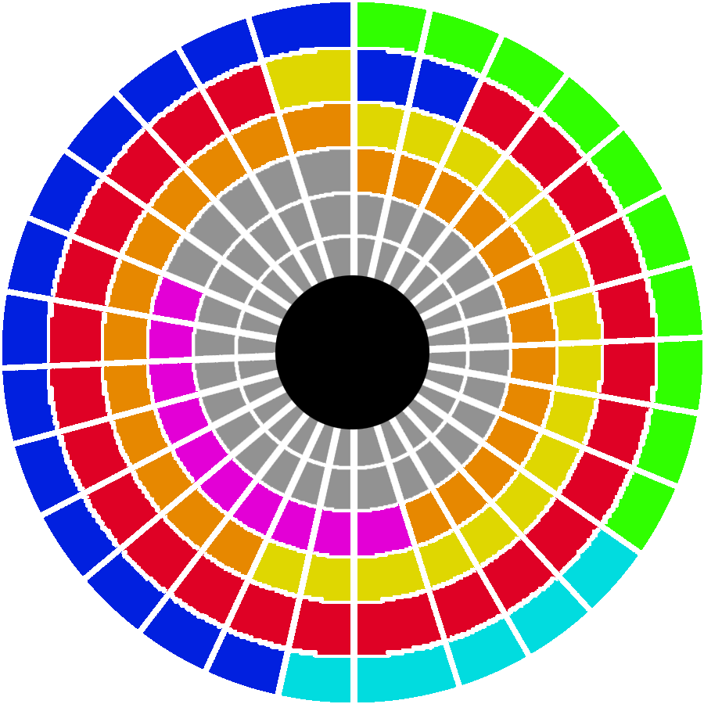
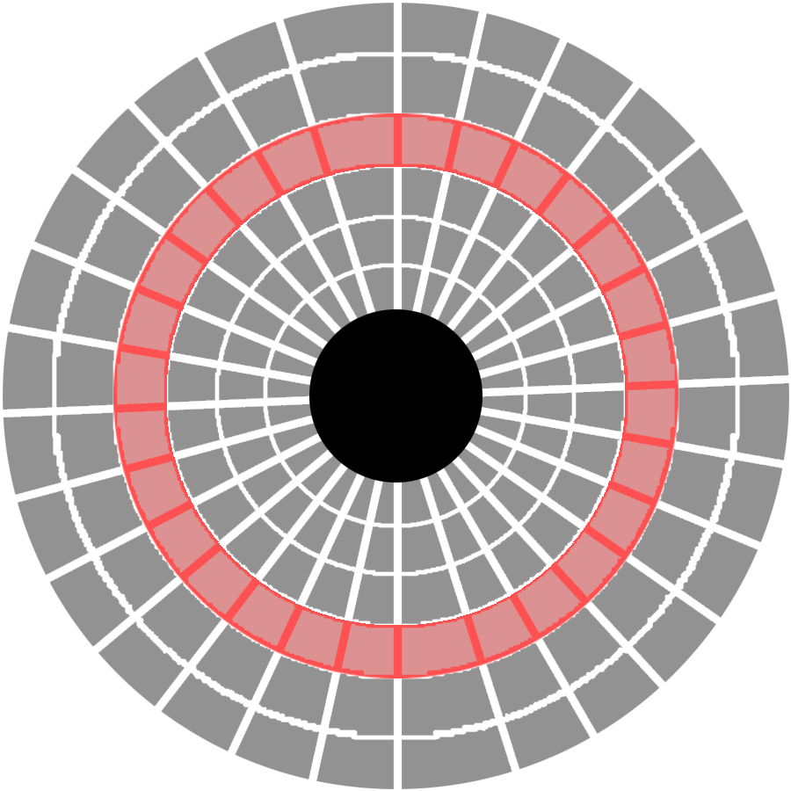

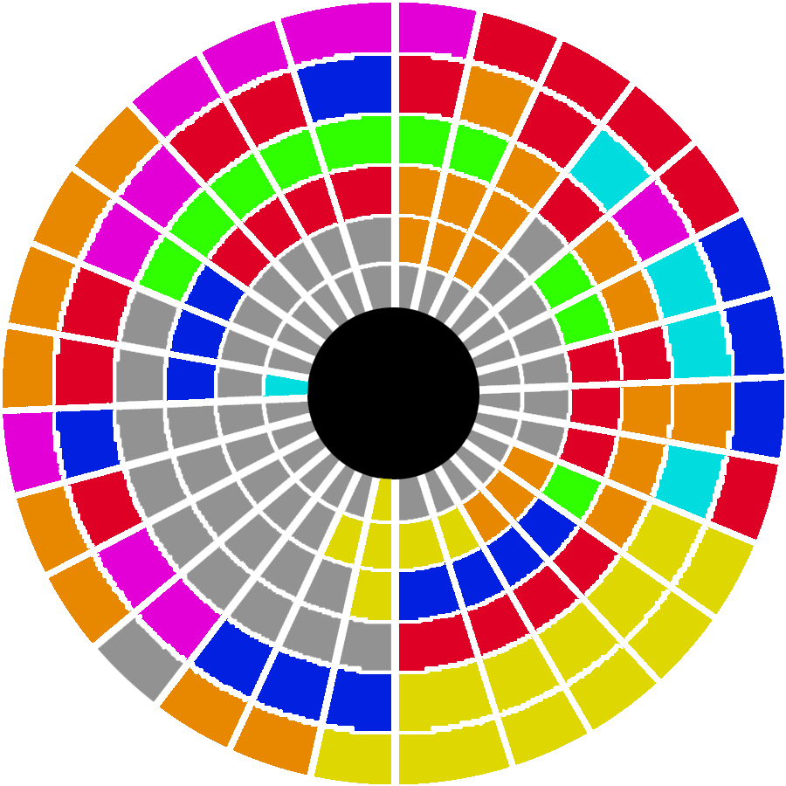

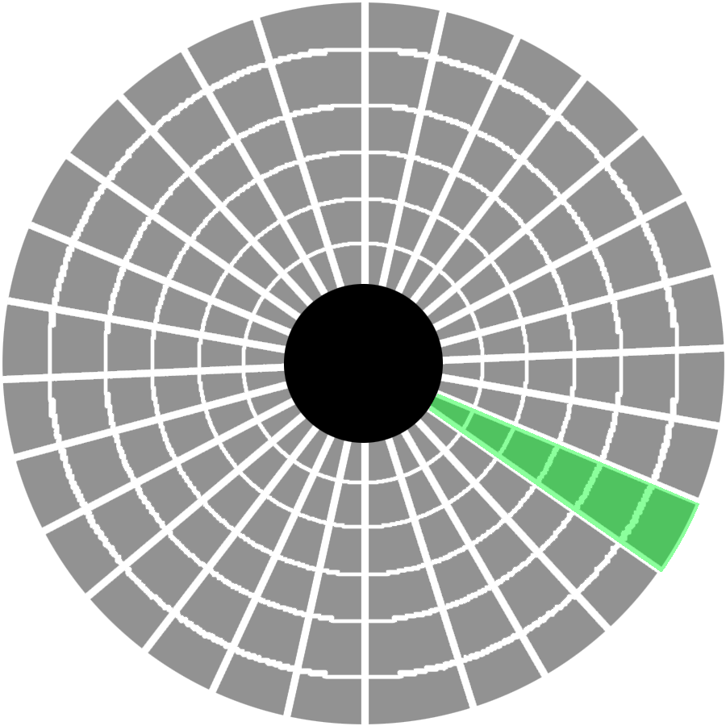
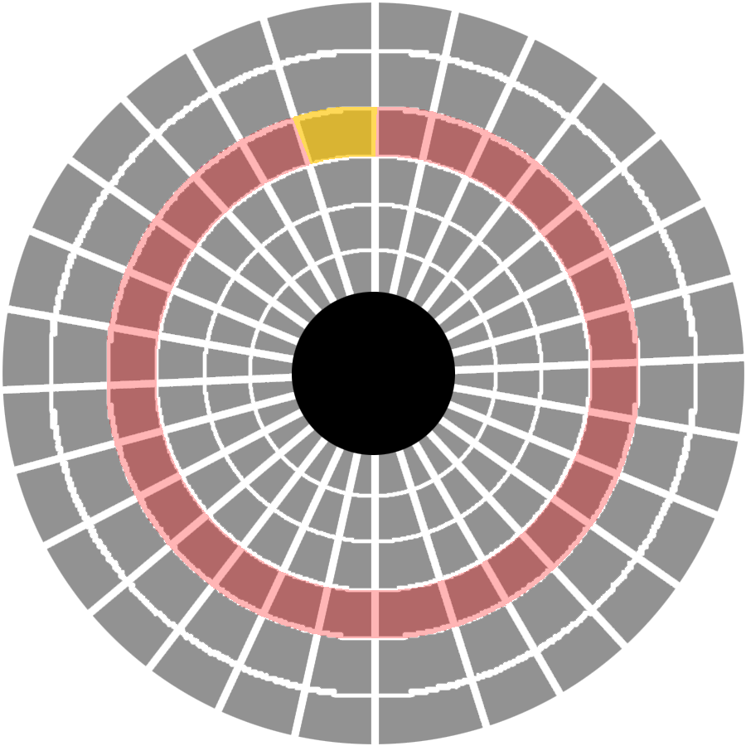

Defragmentation
System Software
Hard drive
TRACK
Track sector
Cluster
Disk Sector
Fragmented Disk
Defragmented Disk
The Drive head

Slide 47
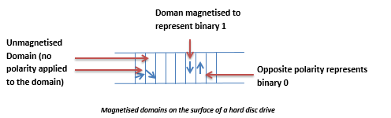

Slide 48
The data is stored in a very orderly pattern the disc surface. Bits of data are arranged in concentric, circular paths called tracks. Each track is broken up into smaller areas called sectors; forming a block of data. When the contents of the disc are being updated data is transferred between the processor and the disc in sectors. Each sector can be accessed randomly using read/write heads which move backwards and forwards across the disc. The disc rotates underneath the read/write heads.

Slide 49
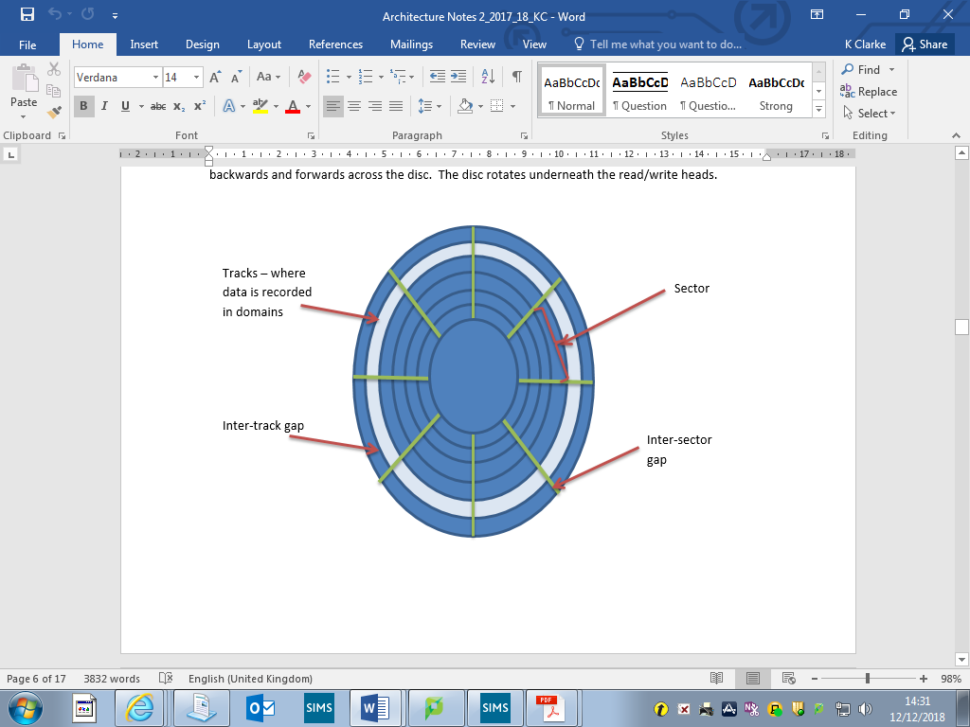
The hard drive inside your computer will have an assembly of hard disc surfaces (called platters). Most hard discs will have more than one platter to increase the storage capacity of the device. The drive shown here has three platters and six read/write heads so data can be read from and written to all surfaces in the disc pack.

Slide 50
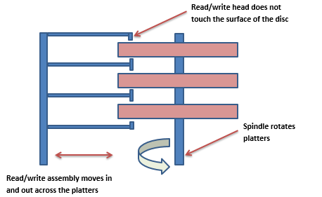
The read/write heads are on a fixed assembly unit which means all of the read/write heads move in and out at the same time. Before data can be stored on the surface of a disc it is processed first using a complex mathematical formula to determine the location for storage. All of the read/write heads will move into place and the read/write operation can then take place.

Slide 51
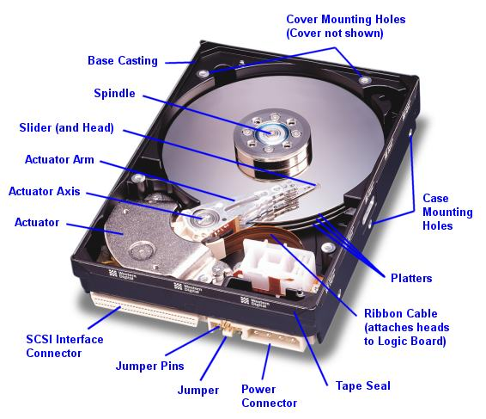
During the write process as one track on a disc surface fills up the corresponding track on the surface underneath will be used to record the rest of the data associated with that file; building up what is known as a cylinder of data or a seek area.

Slide 52
There are two types of hard disks (standards):
IDE (Integrated Device Electronics)
  Standard interface in PC's
  More common than SCSI
  Cheaper and slower than SCSI
  IDE is by far the most common standard, because it is 'good enough' for most purposes. However, if you wish for high speed and a more robust \ reliable system then SCSI offers an alternative.
SCSI (Small Computer Systems Interface)
  Faster - high speed of transfer than IDE
  More reliable than IDE
  Specialist card required
  More expensive than IDE.

Slide 53
Using hard disks as a storage media
Advantages | Disadvantages
Large storage capacity | Hard disks eventually fail which stops the computer from working.
Stores and retrieves data much faster than a CD-ROM | Regular 'head' crashes damage the surface of the disk, leading to loss of data in that sector.
Data is not lost when you switch off the computer | The disk is fixed inside the computer and cannot easily be transferred to another computer.
Usually fixed inside the computer so cannot get mislaid.
Cheap on a cost per megabyte compared to other storage media.
Hard disks can be replaced and upgraded as necessary
Can have multiple hard disks in a machine, one can act as a mirror of the other and create a backup copy.

Slide 54
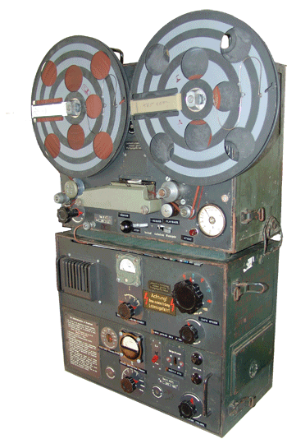
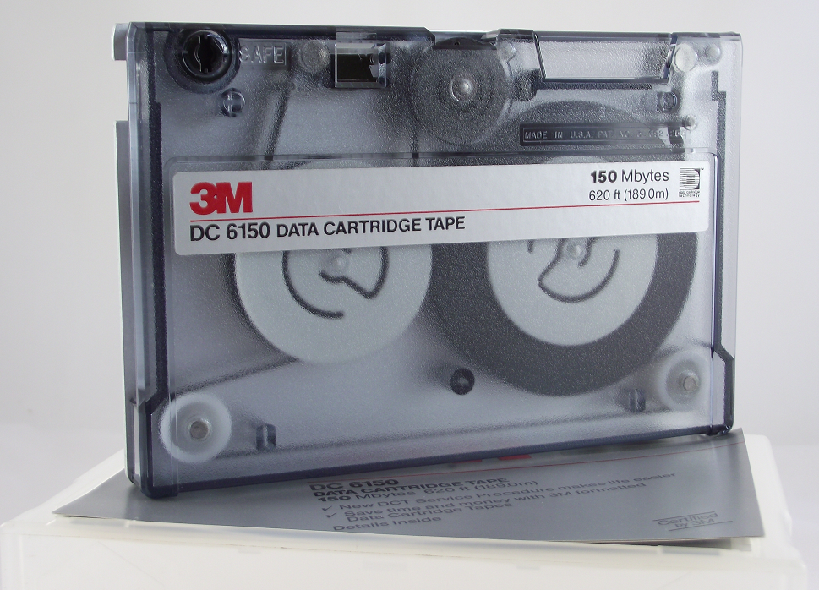
Magnetic tapes come in two forms
Tape reels - these are fairly large and are usually used to back up data from mainframe computers.
Cassettes or cartridges - these are fairly small in size but able to hold enough data to back up the data held on a personal computer or a small network.
As it takes a long time to back up onto magnetic tape, it is usually done at night or over a weekend when the computer network is not in heavy use.
A magnetic tape reel
A magnetic tape cartridge or Digital Audio Tape (DAT)

Slide 55
Pros and Cons
Relatively cheap
Can hold in excess of 20GB of data (it is possible to get devices that will back up over 200 GB of data)
Backup capacity is easily expanded by simply using more tape.
Serial access - this means that in order to get to something on the tape, you have to go through everything that comes before it. Think of it like a video tape. The program that you want to watch might have been recorded half way through the tape, but you have to wind forward right from the start to get to it.
Slow - Because of serial access, it is relatively slow to find the data that you need (however in an exam question, don't just say 'slow', compare it to a storage device with faster access.
Specialist hardware is needed to read the tapes. Most standard PCs do not come with the hardware required to use them.

Slide 56
Optical Media
Optical storage refers to any storage media where data is held in digital format and which are read from or written to using a red laser. CD’s, DVD’s, Blu-Ray discs are all examples of optical media.
The surface of an optical disc is coated in a thin layer of aluminium to make a reflective surface. Data is stored in the form of pits (for binary 0) and lands; elevated areas on the surface of the disc, (for binary 1). The pits are the indentations, and the lands are the areas between the pits.
To read the content of the disc, light is shone onto the surface of the disc from a laser. A pit reflects light more dimly than a land, and a diode is used to measure the difference in reflectivity to determine if a one or a zero is being represented.
  To write 1, the laser beam is turned on, which turns a pit up to the reflecting layer.
  To write 0, the laser beam is not turned on and hence, no pit is burned.

Slide 57
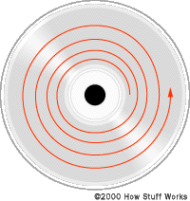
How CDs Work
When retrieving data the change in height between the pits and lands results in a difference in intensity in the light reflected. By measuring the intensity change the data can be read from the disk.
The transition between a pit and a land corresponds to a 1 in the digital bit stream.
The pits and lands used to record the data on an optical storage device are arranged in a long, tightly wound spiral. The spiral starts in the centre of the disc and continues out towards the outer edge of the disc.
The tighter wound the spiral of data is, the higher the capacity of the disc.

Slide 58
CD-ROMs used for distributing software and music files are created using a glass master which is used to burn the pits on the surface of the disc using the method explained above.
CD’s typically use a laser with a 780 nm (nanometer) wavelength to read from and burn data onto the surface of the disc.
CDs are useful for
  Backup
  Transferring files that do not fit onto a floppy disk
  Providing data that you do not want altered by someone else e.g. – software programs or technical manuals.

Slide 59
Pros and Cons
Data cannot be erased from CD-ROMs
CD-ROMs are small and portable
Very cheap to produce
CD-ROMs have a much larger storage capacity than floppy disks.
Will usually work in a DVD drive.
Fairly fragile - easy to break or scratch
Because they are portable they can be lost.
Smaller storage capacity than a hard disk
Slower to access than the hard disk

Slide 60
CD-R
These disks are blank but have been designed to be written onto once only. The 'cd-writer' drive uses a laser to burn tiny pits onto the spinning surface of the CD-R media. Each pit represents a '1' data bit. Once the pit is burnt it cannot be erased.
Sometimes your CD Burning software may allow you to burn a 'multi-session' disk. All this is doing is treating the CD-R as a number of smaller areas or 'sessions'. Each time you start a new session, the drive simply moves to another blank part of the disk.

Slide 61
CD-RW
Often described as 'CD Read-Write'. This technology allows the same area of the disk to be over-written many times (about a 1000 times).
There are two problems with the CD-RW disks - unlike CD-R some drives have a problem reading CD-RW disks that have been burnt by other manufacturers' drives. Secondly, CD-R disks are now so cheap that it is less hassle to simply use a blank disk!
A typical CD-ROM can store approximately 650 megabytes of data

Slide 62
DVD
DVDs stands for Digital Versatile Disk. a DVD disc can store between 5-17 gigabytes of data.
  This amount of storage makes it possible to store complete movies along with special features and multiple language tracks.
A single layer DVD has a capacity more than seven times the size of a typical CD. A DVD uses a laser with a 650 nanometer wavelength, which means it can burn smaller pits onto the surface of the disc.
  Since the same light is focused onto a smaller surface then more data can be recorded on the available area.
Dual layer DVDs operate by placing another semi-transparent layer on top of the original. In order to read the second layer the angle of the laser is altered to focus either on the bottom layer or the top layer when reading the data.

Slide 63
DVDs: Pros and Cons
Very large storage capacity
Sound and picture quality is excellent which makes them suitable for video and sound
Increasing availability
Price is dropping for both DVDs and DVD drives.
Does not transmit viruses
DVD players can read CD-ROMs.
Still a relatively new technology so still expensive compared to CD-ROMS.
DVDs do not work in CD ROM drives.

Slide 64
Blu-Ray Disks
Is an optical disc storage medium.
Its main uses are high-definition video and data storage. The disc has the same physical dimensions as standard DVDs and CDs.
The name Blu-ray Disc is derived from the blue laser (violet-colored) used to read and write this type of disc.
Because of the wavelength (405 nanometres), substantially more data can be stored on a Blu-ray Disc than on the DVD format, which uses a red (650 nm) laser.
A two-layer Blu-ray Disc can store 50 gigabytes, almost six times the capacity of a two-layer DVD, or ten and a half times that of a single-layer DVD.
Blu-Ray
DVD

Slide 65
Flash Storage
Flash memory uses solid state technology to store data on a non-volatile storage medium.
Since there are no moving parts (everything is electrical as opposed to mechanical) the contents of flash memory are therefore electrically erased and reprogrammed multiple times.
Flash storage media use transistors to store data. A normal transistor has 3 main components, called the source, the drain and the gate or control gate.
  The transistor operates like a pipe and is used to carry electricity from the source to the drain.
  In between the source and the drain is a gate or control gate which can be opened or closed to switch the transistor off, representing binary 0.
  When the control gate is opened and the transistor is therefore switched on it represents a binary 1.
A flash transistor is a little different. It has an additional gate called a floating gate positioned above the control gate. The floating gate is insulated from the rest of the transistor so it can store some of the electrical charge used to represent the binary data. Even when the power is removed the electricity is trapped in between the two gates so the binary data is retained.
The data can be erased by applying a negative charge to the transistor to make the trapped electricity drain back down again away from the floating gate. The process of removing trapped electricity from the floating gate is known as tunnelling.

Slide 66
Backing Up Vs. Archiving
Backing up your data is where you make a copy of what is on your system. However, the original data is still left in place. The backup can be stored somewhere separately and just used in case the original data gets corrupted or deleted, or the hard disk gets damaged/stolen.
The backup can be used to restore your data to an earlier version.
The key point is that if you make a backup, you are not deleting or moving the original data - it stays in the same place
Archiving is where you want a copy of your data/records, but you no longer need to keep it on your system. Once the data is archived, it is usually removed from the system and the archived copy is kept elsewhere.
This frees up space on the hard disk or wherever the data was originally stored.
Notes:
We’ll look at these in more detail later in the course

